Slide 1
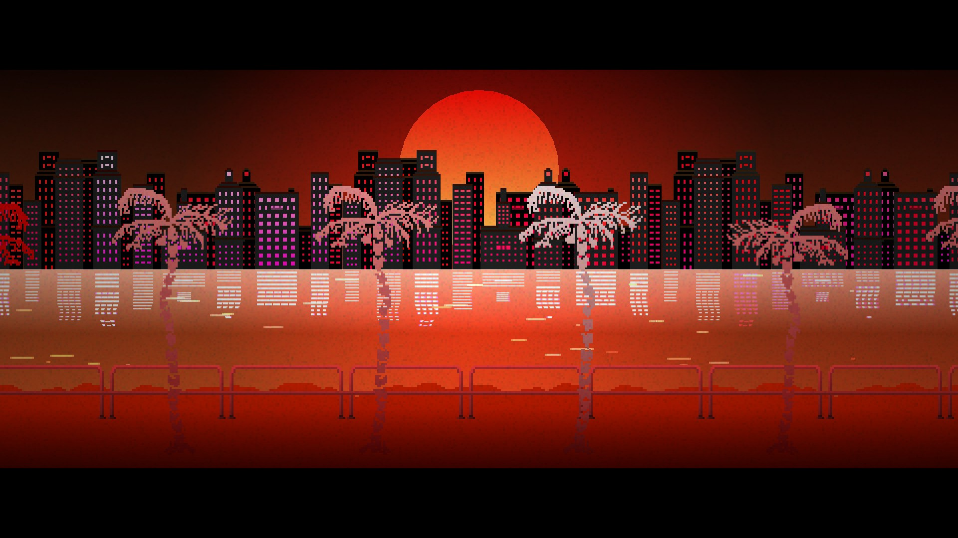
Bill and Omar’s Excellent Adventure
Mega Men: Omar Rana & Bill Vangos
Notes:
Introduction

Slide 2

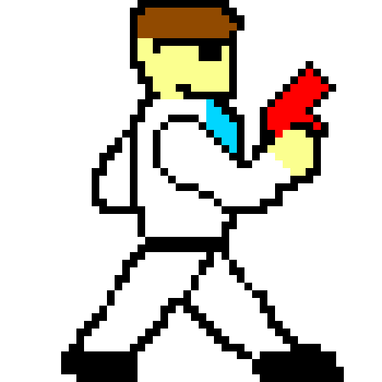
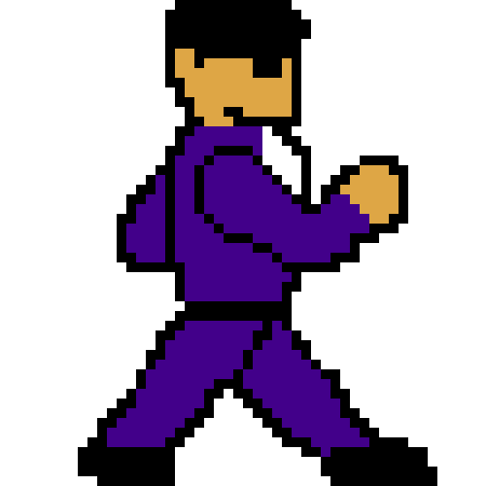
Goals
Creating an original arcade-style side-scroller game akin to Mega Man, Metroid, and Contra
Long and challenging campaign mode with varied level design and boss battles
Functional in the arcade cabinet
Prime entertainment for anyone who enjoys a challenge who happens to find themselves in the Photonics building
Notes:
Basically we’re making a single-player game where you run, jump, and kill enemies. We want to put it in the arcade cabinet.

Slide 3
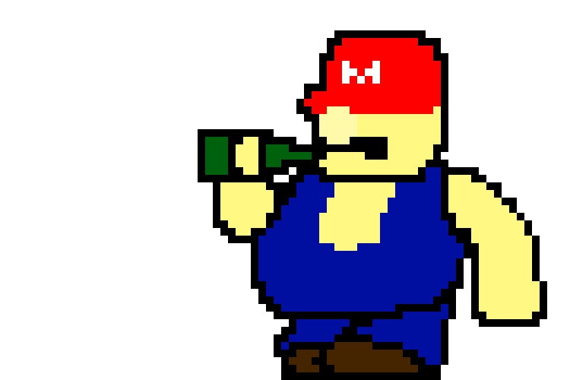
Short Functionality
Player character can move left, right, and jump up to and down from platforms, as well as attack
Enemy AI characters will patrol defined locations and attack the player character when a fatal attack can be inflicted
Boss battles will have unique AI to challenge the player
Notes:
Basic outline of how the characters interact with each other.

Slide 4
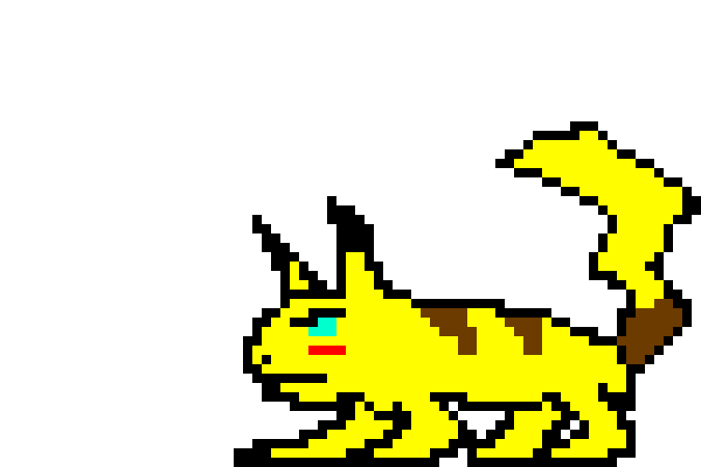
Short Functionality
Custom spritesheets were designed, saved as .png files, converted to .coe files, then converted a last time to .bin files
These .bin files are then loaded into the SRAM of the FPGA and are accessed by our code
Animations are created by cycling through the spritesheet of each individual sprite to create a smooth transition
Notes:
How were animations handled? By a series of conversions being loaded into the SRAM so that the animations can cycle properly and smoothly.

Slide 5
Short Specification
Creating an original side-scroller adventure game inspired by the retro classics
Play as two different characters
Design custom artwork with homages to classic games to display through the VGA display
Use the Digilent Nexys3 Spartan-6 FPGA Board
Functional game controls through JAMMA Interface for arcade cabinet
Load sprites into memory using the Adept Tool
Notes:
What were our goals?

Slide 6
Detailed Functionality
Player Movement:
Buttons: Left, Right, Up (Jump), Down, Attack
Clock Divider samples button presses
No Debouncer (yet)
Y-Coordinate control registers base_y and top_y are set by the players position relative to the platforms
Verilog Example
X-Coordinates are bounded by the edges of the screen
Notes:
How was movement handled? Testing was done on the board itself for controls, but we eventually moved onto the JAMMA interface in the final implementation.

Slide 7
Detailed Functionality
Player Combat:
Checks if player holds down the attack button (so that the animation doesn’t freeze in the attack pose)
If the character faces right, the animation punches to the right side
If the character faces left, the animation punches to the left side
If the character models are within range of each other (x coordinates), and on the same platform (y coordinates), a killing blow can be dealt
Notes:
How does combat work? Pretty self explanatory, but essentially it boils down to hit detection boundary boxes.

Slide 8
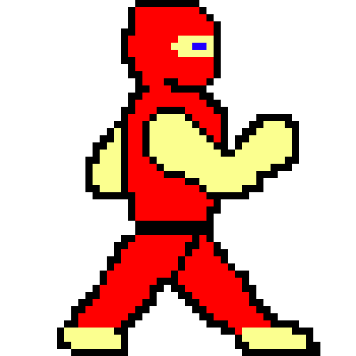
Detailed Functionality
Enemy AI:
“Patrol” areas defined by us based on the specific level design
Once they reach a certain x coordinate, turn around and walk the other way
If the player is within a certain x-range, attack
Notes:
How do enemies know where to go?

Slide 9
Detailed Functionality
Ram Controller:
Reads data in based on the address calculated by the sprite controller
Reads in two bytes at a time, but we only “use” the most significant byte at a time after any given read
Gives the ability to use much larger backgrounds and lengthier animations
Special thanks to Metal Squad (Street Fighter team) for the help
Notes:
How did we fit everything in the design? Before we had lots of trouble simply putting everything into the block ram from the Core Generators. This was our solution.

Slide 10
Detailed Functionality
Sprite Controller:
Reads into the SRAM and displays different backgrounds, enemy placements, and legal coordinates based on the level counter
Uses static parameters defined as the starting decimal value of the address to “find” the different sprites loaded into the SRAM by adding the corresponding parameter to the address calculation
Notes:
How did we access the memory?

Slide 11
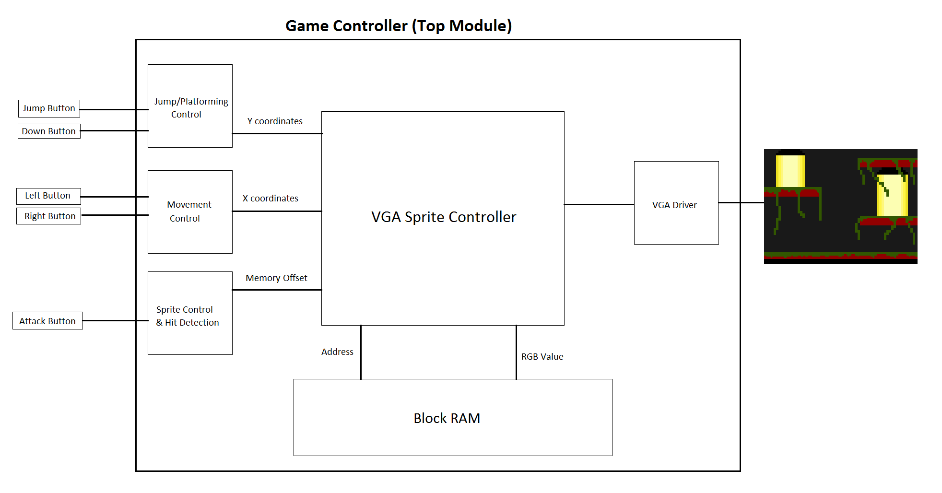
Block Diagram
Notes:
Inputs fed into modules to control movement and combat, fed into the sprite controller which pulls the color information from the SRAM, which feeds the VGA driver.

Slide 12
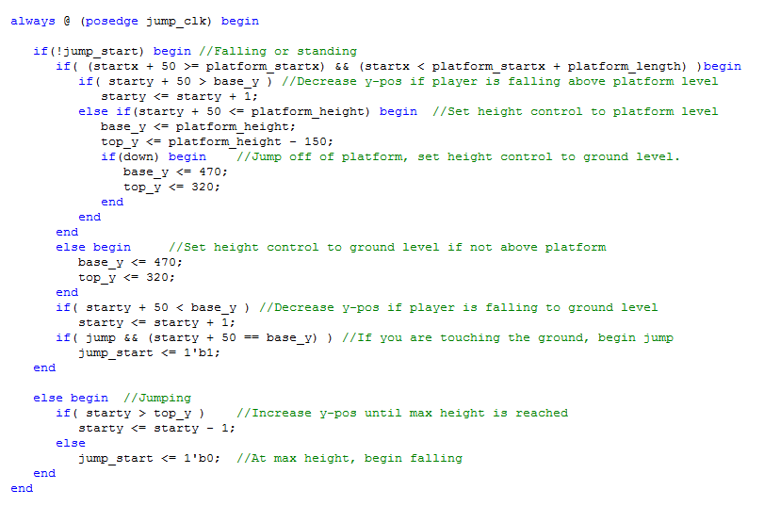
Verilog Example
If you jump, move the sprite upwards by increasing the Y coordinates, then decrease them to fall back to the same level
If you jump onto a platform, the system will check that the character has landed on the platform and will set the new “ground” to be the platform until the player jumps down or moves off of the platform
Notes:
Basic example of our jumping system.

Slide 13
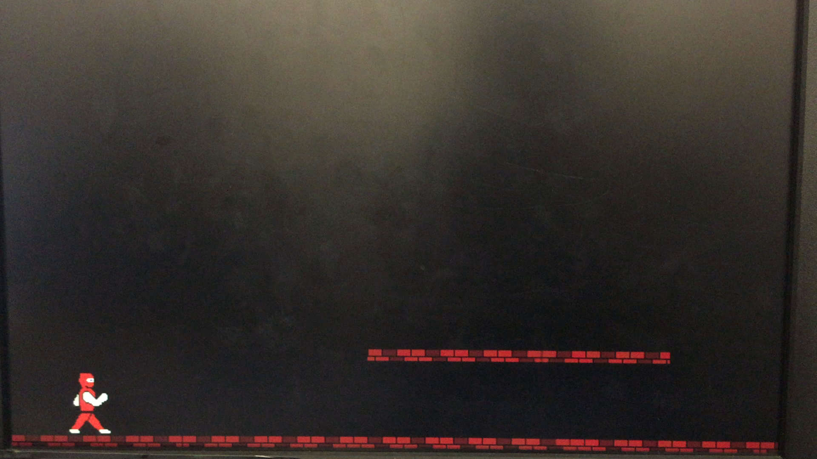
Verilog Example
Notes:
Video demo of jumping system.

Slide 14
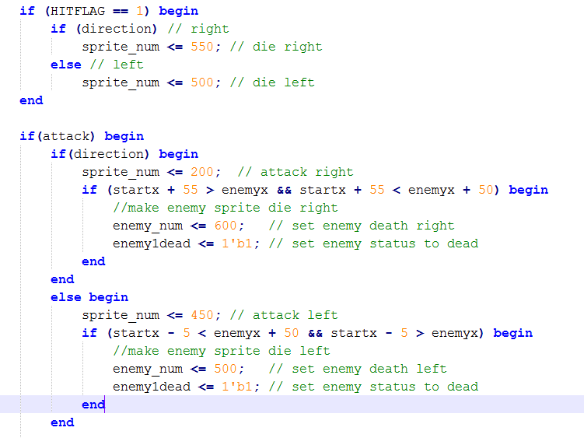

Verilog Example
0
200
450
500
550
500
600
Notes:
Attack/Death sprite handling.

Slide 15
Successes (Complete Features)
Complete Menu System
Title Screen
Game Over Screen
Complete Movement System
Left, Right, Jumping up and down
Collision detection with walls, platforms
Complete Combat System
Able to kill enemies
Able to be killed by enemies
Special boss battles
Complete Graphics
Fully animated character sprites
Custom backgrounds with unique platforms
Notes:
What works?

Slide 16
Failures (Incomplete Features)
Imperfect Graphics (fix imminent)
Although sprites and animations load perfectly, there is a slight graphical error where the null/transparent pixels appear as black pixels
Multiplayer Mode & Audio Controller
Removed due to time constraints
More Content
More levels, enemy types, and boss battles
Notes:
What doesn’t work?

Slide 17
Still to Do
Finish implementing more levels, enemies, and bosses
Complete JAMMA interface testing
Fix transparent graphic error
Complete game documentation with full SRAM load-order list
Notes:
What needs to be done from now until the final submission/demo?

Slide 18
Design Tradeoffs
Memory Limitation
Due to the constraints of memory, we have been forced to simplify a lot of the animations so that the spritesheets can reduce in size
Time Constraints for Content
Setbacks after dealing with memory loading issues have resulted in a simplified combat system (one attack instead of two) and fewer unique enemy types
Full features such as the audio controller and a multiplayer mode have also been removed
Notes:
What had to be sacrificed to complete this project?

Slide 19
Work Split
Omar:
Sprite design
Memory loading
Animations
Menu system
Bill:
Movement system
Combat system
Platforming system
Notes:
How was the work divided? Given the fact that there were only two of us, most of these were collaborative.

Slide 20
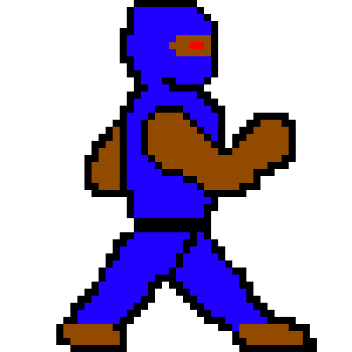
Demonstration of Progress
Notes:
Enemy sprites.

Slide 21
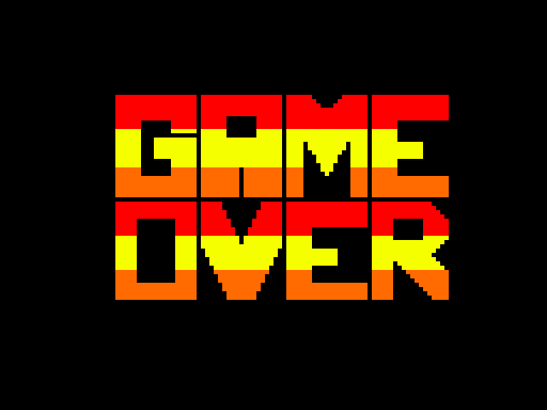
Demonstration of Progress
Notes:
Bill & Game Over screen.

Slide 22

Demonstration of Progress
Notes:
Omar and Explosions.

Slide 23
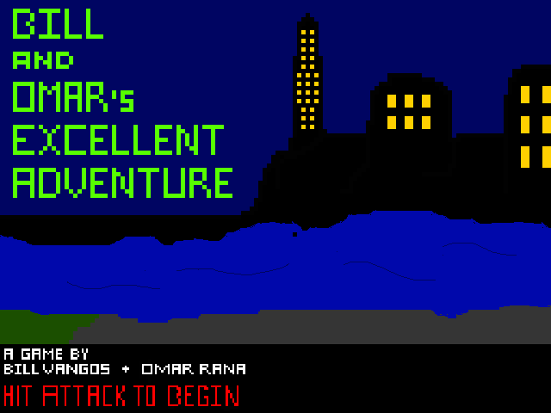
Demonstration of Progress
Notes:
Title screen.

Slide 24
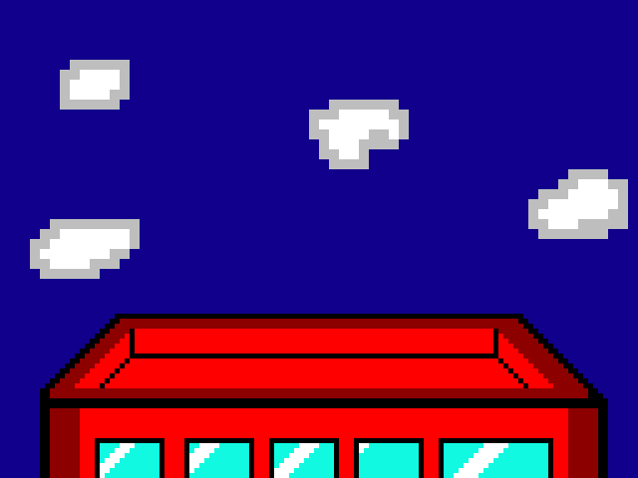
Demonstration of Progress
Notes:
Rooftop level.

Slide 25
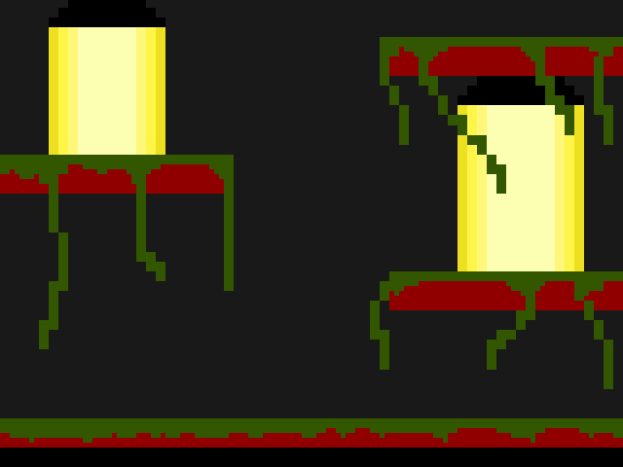
Demonstration of Progress
Notes:
Swamp level.

Slide 26
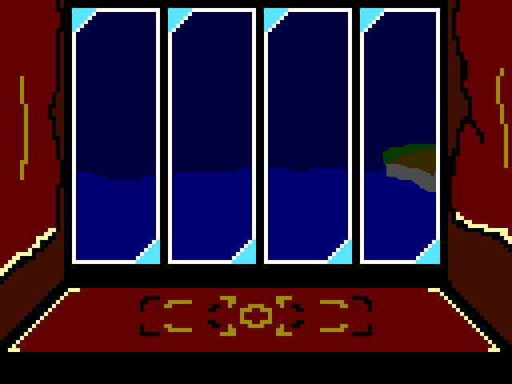
Demonstration of Progress
Notes:
Boss Room level.

Slide 27
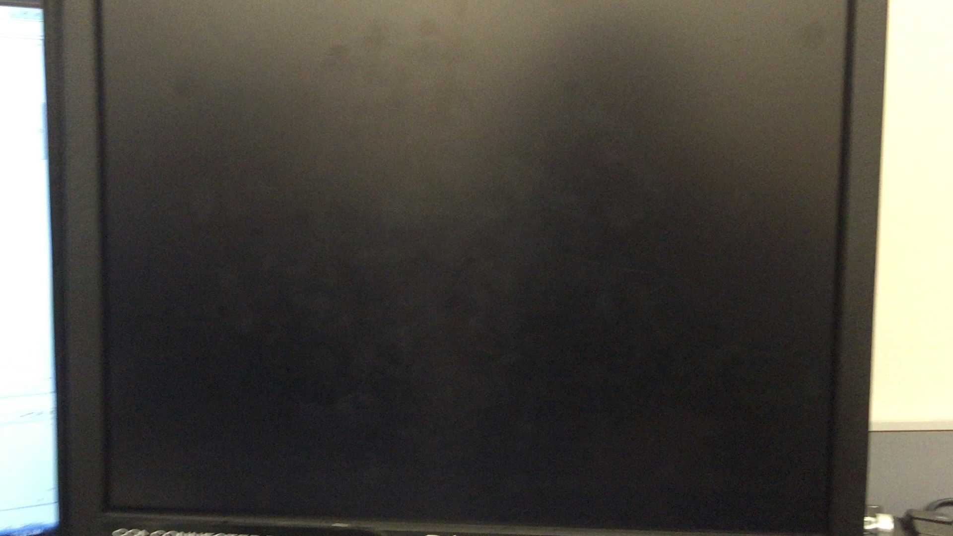
Demonstration of Progress
Notes:
Demonstration video.

Slide 28
Demonstration of Progress
Notes:
Fix to the transparent block issue.

Slide 29
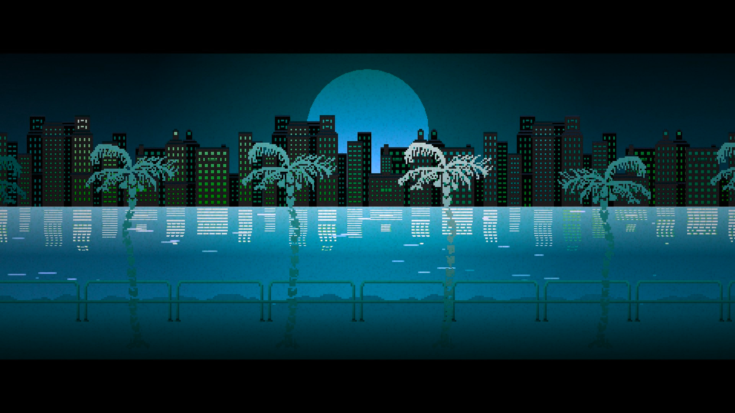
Bill and Omar’s Excellent Adventure
4.30.15
Notes:
Fin.

